Slide 1

Cyclistic
Differences Between Members and Casual Riders
Google Analytics Case Study
Presented By: Dianellys Brioso
Last Updated: 01/12/2023

Slide 2
Table of Contents:
Objective
Data discoveries from: (Cyclistic Bike Share 2022)
Conclusion

Slide 3
Objective :
To determine how annual members and casual riders use Cyclistic bikes differently in order to better strategize how to convert casual riders into annual members.

Slide 4
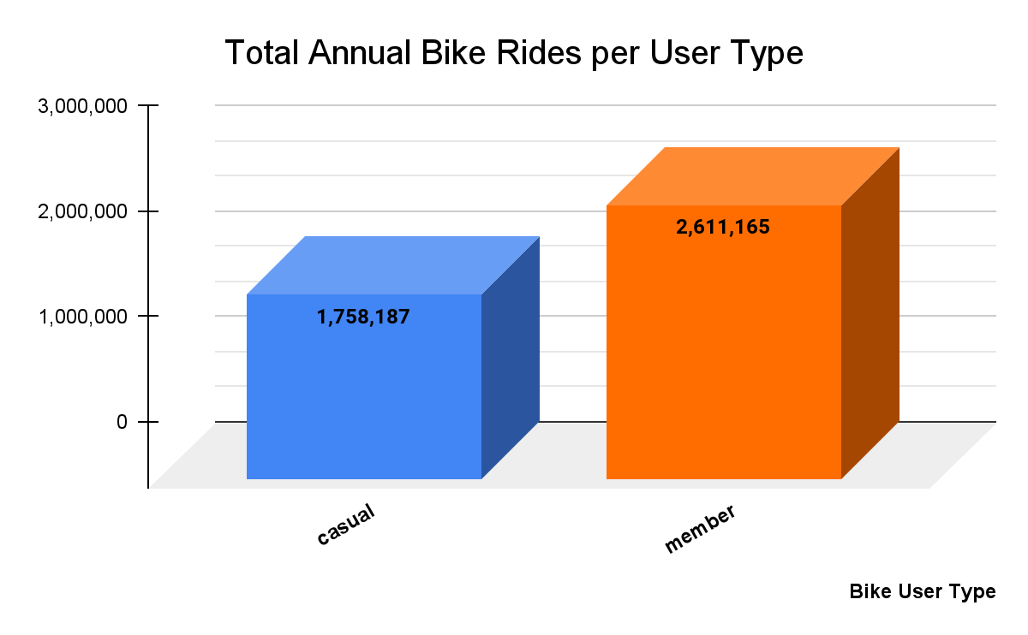
Annually:
Members ride more often than casual riders.
About 32.7 % more than casual riders.

Slide 5
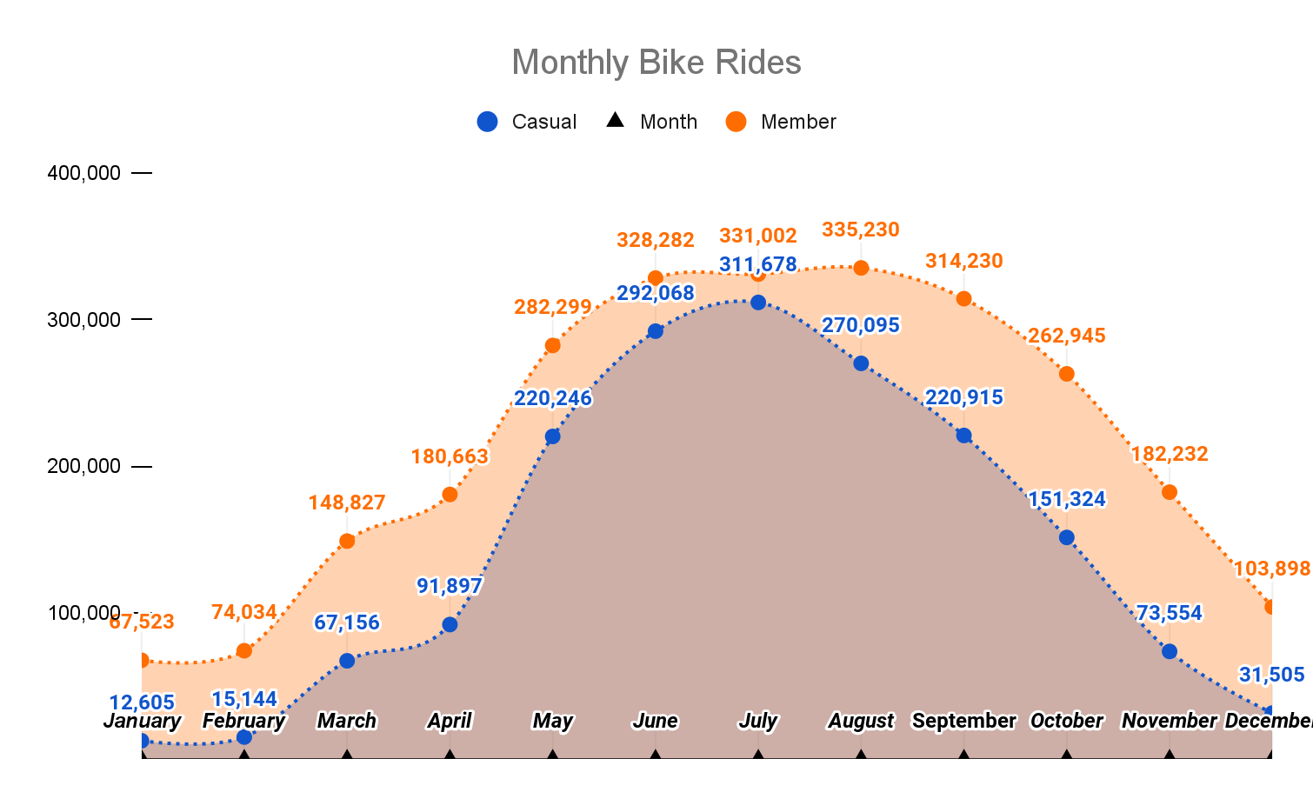
Annually:
Casuals:
Ride most during June and July and least during January and February.
Members:
Ride most during July and August and least during January and February.
Note: Perhaps the weather conditions have an impact here.

Slide 6
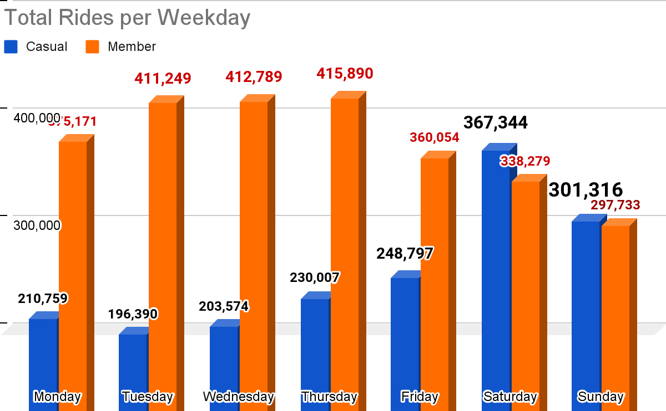
Weekly
Casuals:
Ride least on weekdays and most on weekends.
Members:
Ride most on weekdays and least on the weekends.

Slide 7
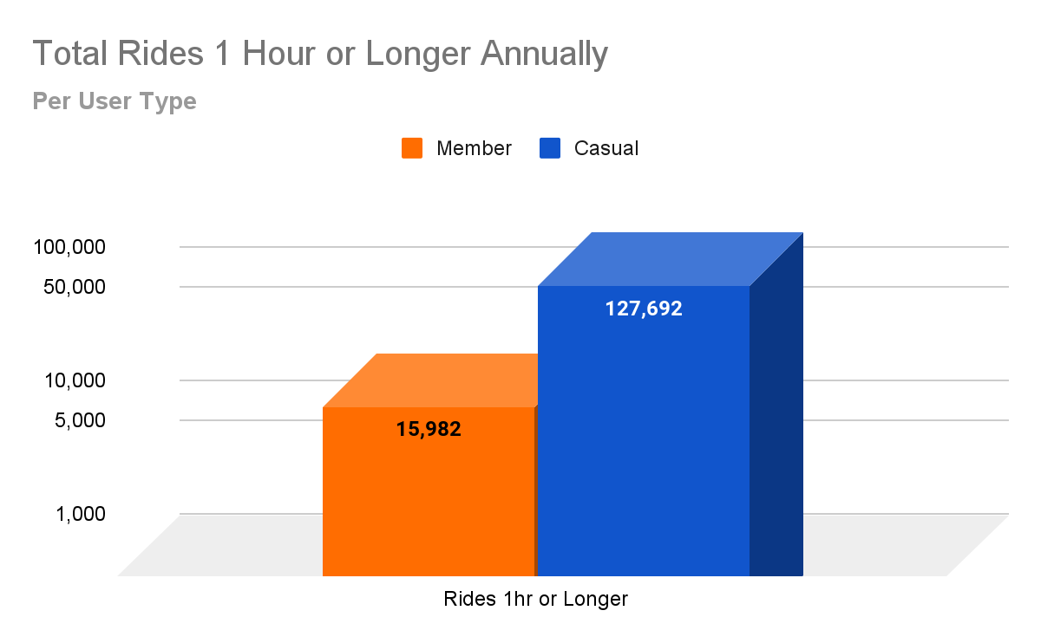
Time Spent on Rides
Annually more casual rides last 1 Hour or longer.
Less than 1% of annual member rides last 1 hour or more.
About 7% of annual casual rides last 1 hour or more.

Slide 8
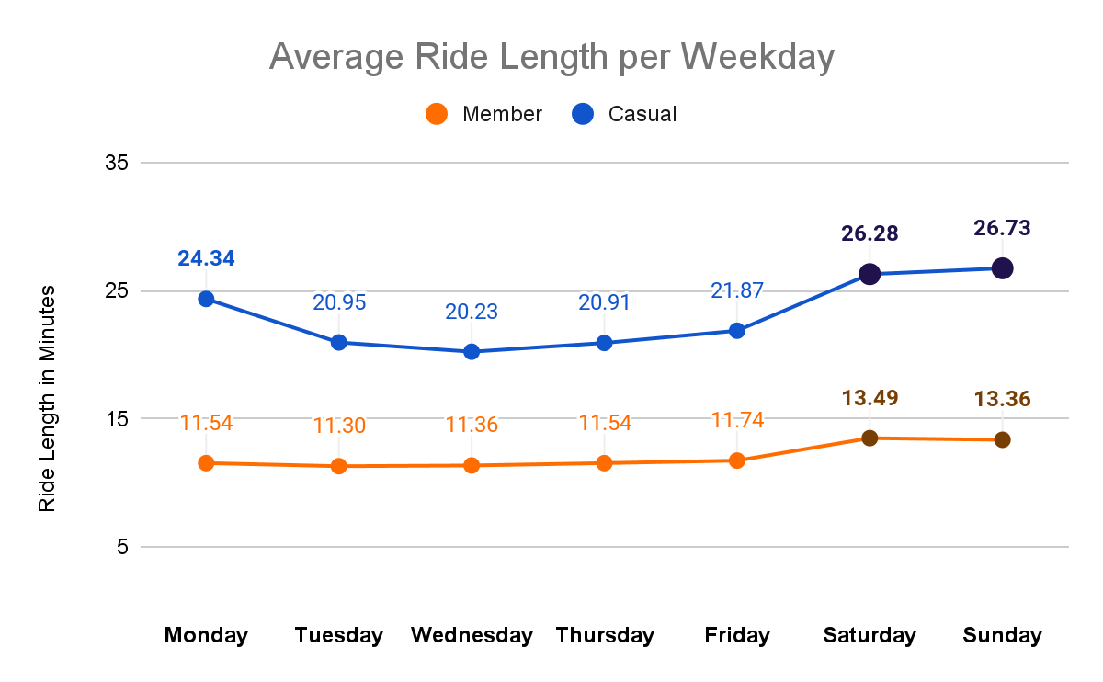
Time Spent Riding
Weekday Average
Casual spend twice as long riding than members, specially on weekends.
Indicative that perhaps casuals ride bikes for leisure and members ride bikes as a means of transportation.
Further analysis needed to discover the reasons both types have for using Cyclistic Bike Share.

Slide 9
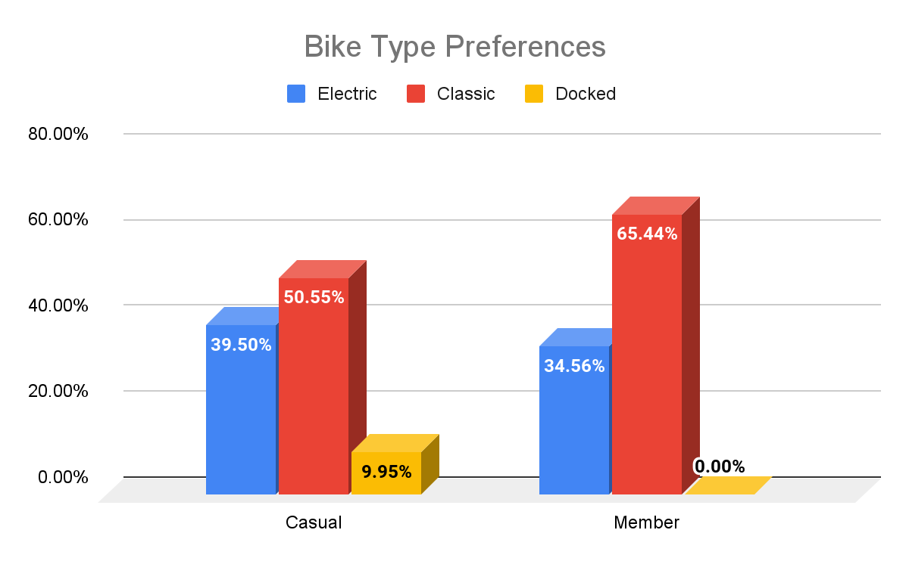
Preferences
Only casuals use docked bikes.
Casuals use electric bikes more than members.
Perhaps marketing efforts can target these preferences.

Slide 10
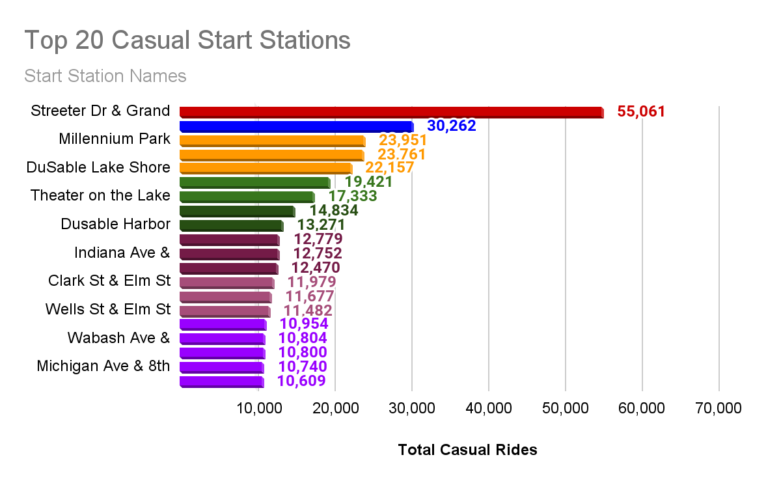
Preferences: Casual
Out of the top-20 most frequented start stations, both groups only share 4 in common.
Marketing efforts can be directed at these locations.

Slide 11
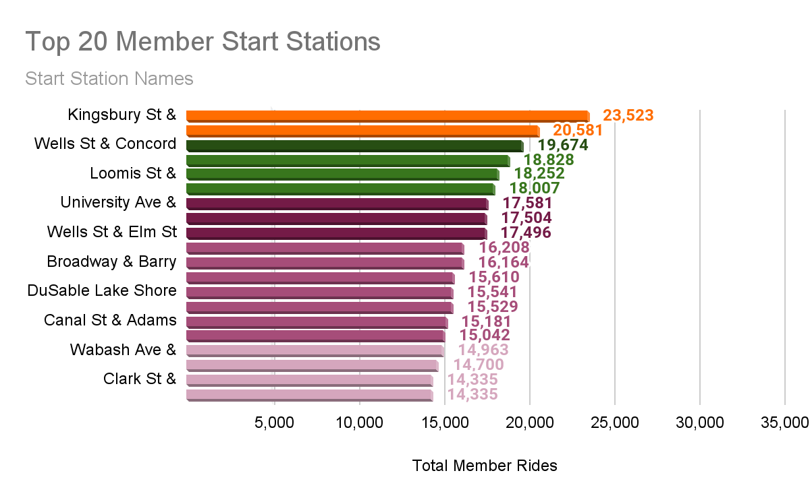
Preferences: Members
Out of the top-20 most frequented start stations, both groups only share 4 in common.

Slide 12
Discoveries
Both groups ride most during the warmer months and least during the colder months.
Casuals use electric and docked bikes more than members.
Some trends are indicative that perhaps casuals ride bikes for leisure and members as a means of transportation.
Members ride more often than casuals, however, casuals ride for longer periods of time.
Casuals ride least during weekdays and most during weekends, specially Saturdays while members do the opposite.

Slide 13
Recommendations
Direct marketing efforts to warmer months and weekends.
Marketing can target the bike preferences and use the top 20 frequented stations as a good starting point.
To better strategize, further analysis is needed to discover the reasons both groups have for using Cyclistic Bike Share.
Further analysis and customer surveys to both groups to discover what casual riders expect in a membership and what attracted the current members.
A new analysis into the similarities in both groups might prove more useful in learning how to convert casuals into members.

Slide 14
Thank You

